Slide 1
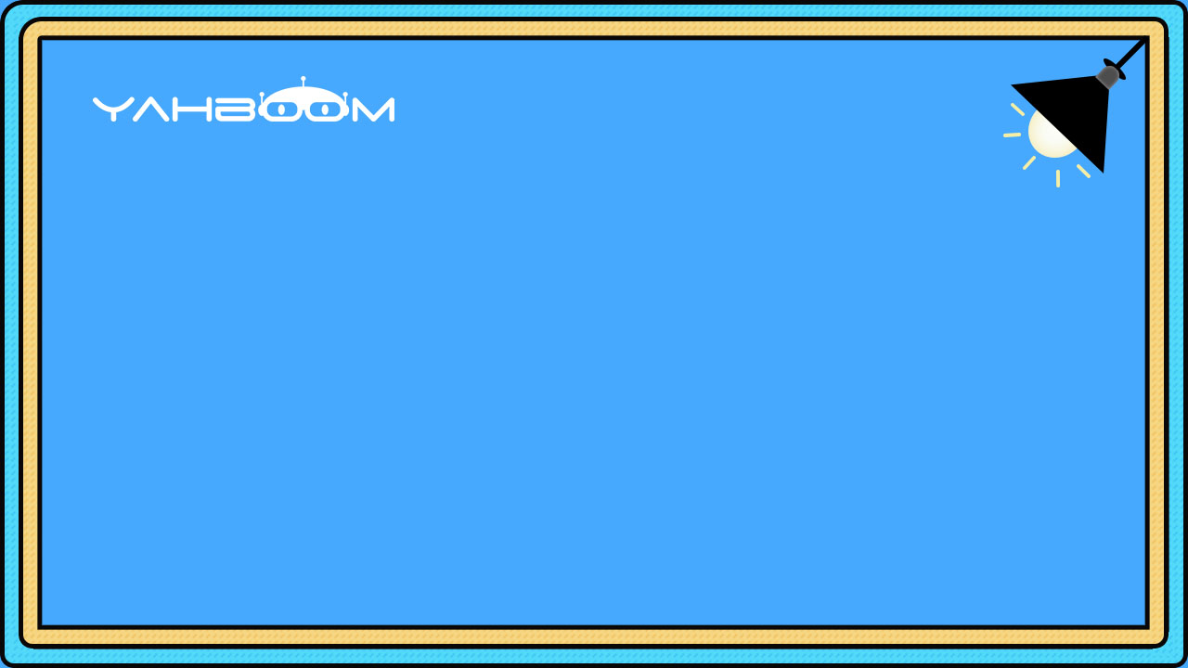

micro:bit programming tutorial
Lesson 7
micro:bit basic lesson 7“Automatic lighting”
Yahboom micro:bit tutorial

Slide 2
micro:bit programming tutorial
Part1
Part 2
Part3
Part 4
Part 5
Learning goals
Preparation
Search for blocks
Combine blocks
Have a try
Yahboom micro:bit tutorial

Slide 3
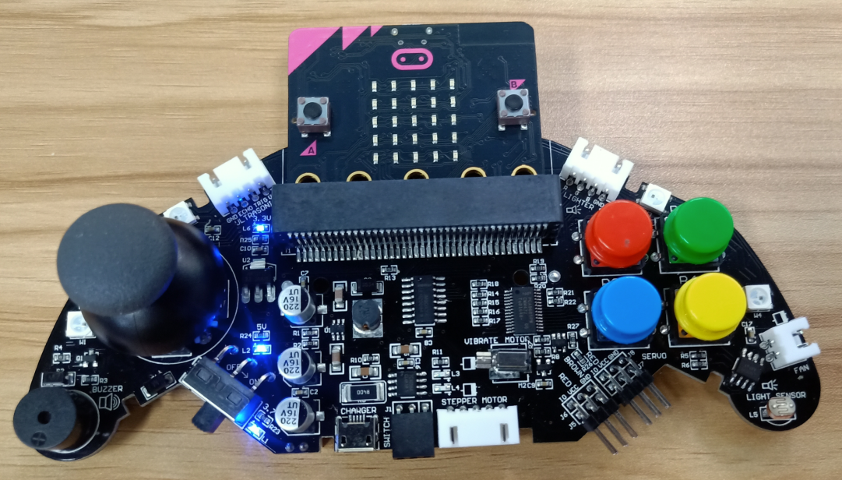
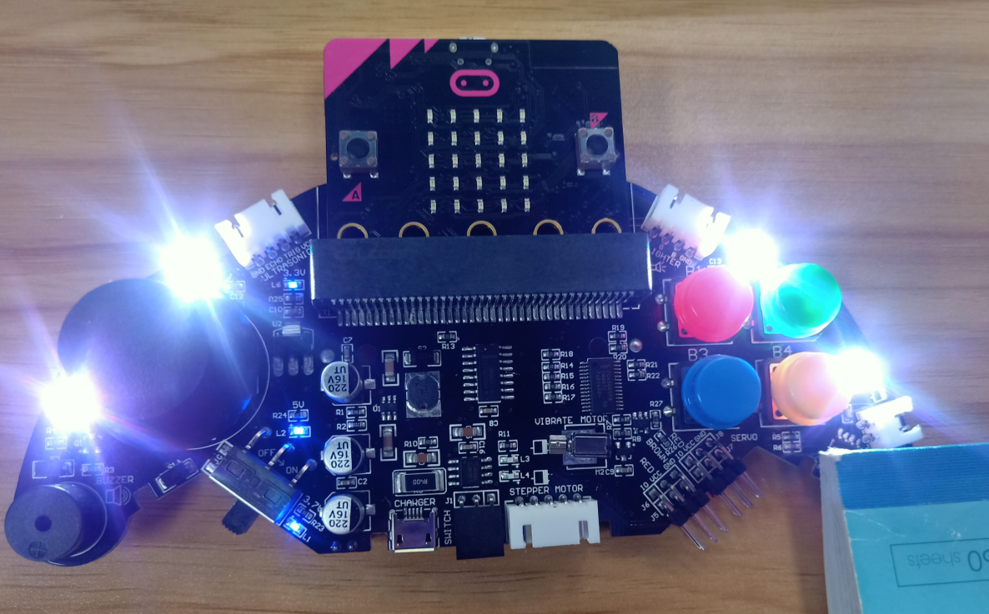
micro:bit programming tutorial
Part1
When the program is downloaded, place the handle in a dark environment and the colorful lights on the handle will light up. When the environment is very bright, the colorful lights will automatically turn off. We can use a book to cover the photoresistor in the lower right corner of the handle. Try it.
Yahboom micro:bit tutorial

Slide 4
micro:bit programming tutorial
Part2
Hardware：
● 1 X micro:bit Game Handle
● 1 X Micro USB Cable
Yahboom micro:bit tutorial

Slide 5

micro:bit programming tutorial
Two programming methods
Part2
1.Online: Connect Micro:bit to the computer via USB cable, and the computer will pop up a U disk and click the URL in the U disk to enter the programming interface.Enter this URL https://github.com/lzty634158/GHBit to get the package named GHBit.
2.offline：Open micro:bit offline programming software and add GHBit package.Click on "Advanced" and select "Add Package".Enter this URL https://github.com/lzty634158/GHBit to get the package named GHBit.
Note: If you already have a GHBit package, you don't need to add it repeatedly.
Yahboom micro:bit tutorial

Slide 6
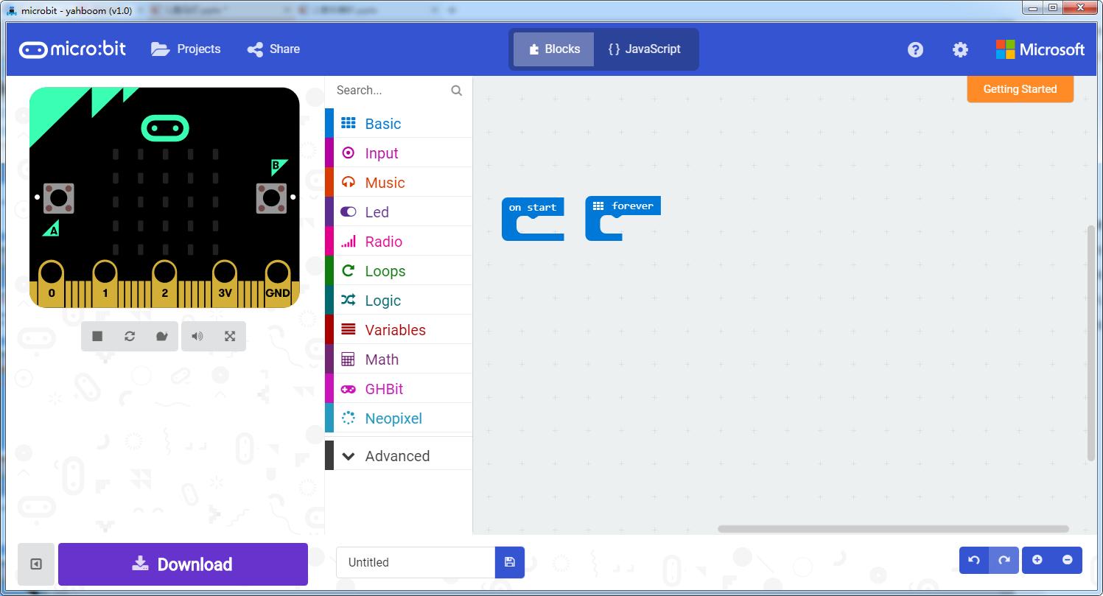
micro:bit programming tutorial
Programming interface
Part3
Yahboom micro:bit tutorial

Slide 7
micro:bit programming tutorial
Programming interface
Part3
Yahboom micro:bit tutorial

Slide 8
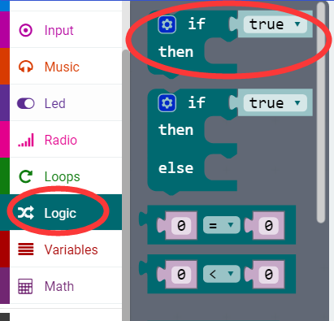
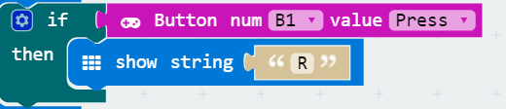
micro:bit programming tutorial
Part3
If a value is true, then do some statements.
For example: If the B1 button of the handle is pressed, the dot matrix display character R is executed. If the B1 button is not pressed, it will not be executed.
Yahboom micro:bit tutorial

Slide 9
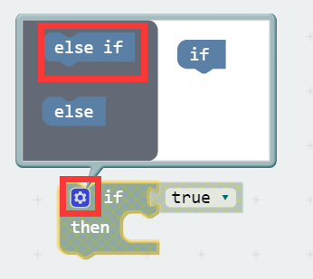
micro:bit programming tutorial
Part3
When there are many choices, you can click on the pinion above. Drag the "else if" on the left to the bottom of the "if" on the right, and click on the pinion again.
Yahboom micro:bit tutorial

Slide 10
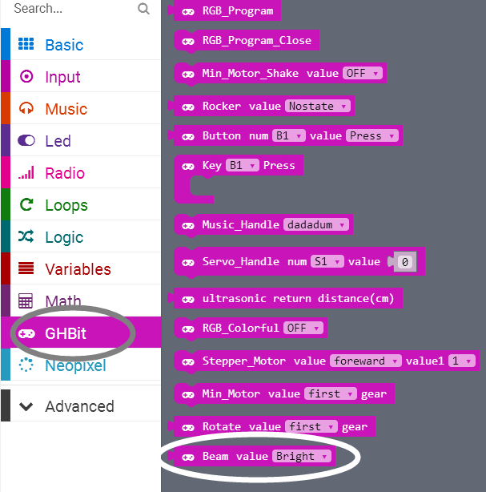
micro:bit programming tutorial
Part3
This building block indicates whether the current environment is day or night.
Yahboom micro:bit tutorial

Slide 11
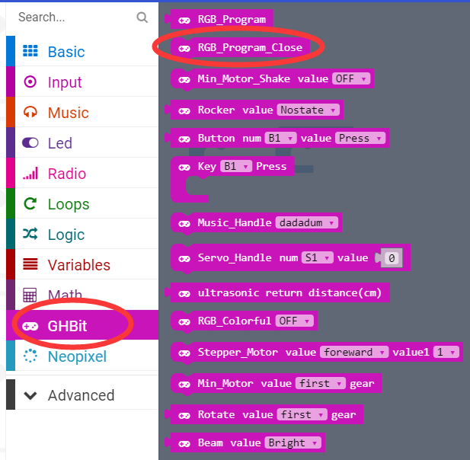
micro:bit programming tutorial
Part3
Turn off the colorful lights.
Note: Every time you complete an experiment on a colorful light, you need to use a program that turns off the colorful lights. Otherwise the colorful lights will remain on.
Yahboom micro:bit tutorial

Slide 12
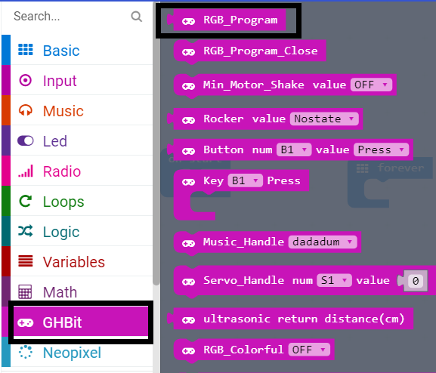
micro:bit programming tutorial
Part3
Use this building block when controlling the lights built into the micro:bit Game Handle.
Yahboom micro:bit tutorial

Slide 13
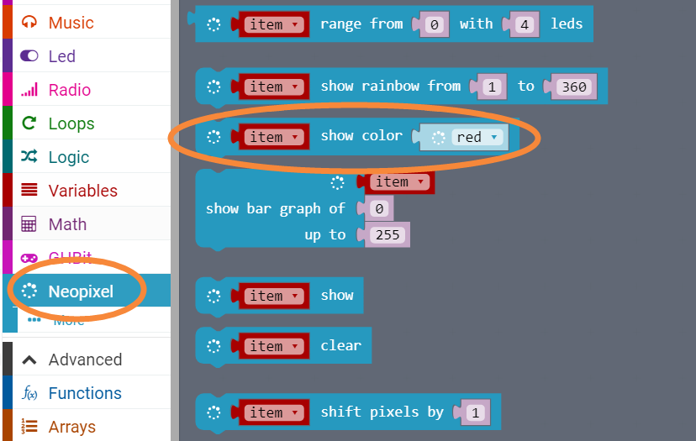
micro:bit programming tutorial
Part3
Select the color that the light on the handle is lit.
Yahboom micro:bit tutorial

Slide 14
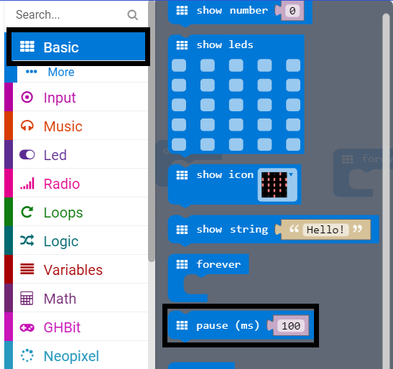
micro:bit programming tutorial
Part3
Pause for 100 milliseconds, in the program we change the value to 1000 milliseconds.
Yahboom micro:bit tutorial

Slide 15
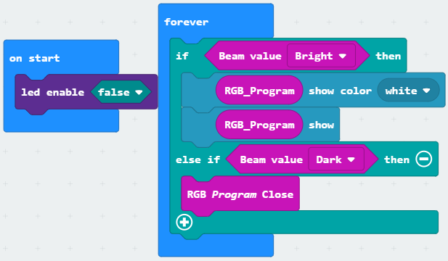
micro:bit programming tutorial
Part4
!Note:
Because the colorful water flow light uses the P4 pin, the photoresistor uses the P10 pin, which is multiplexed with the micro:bit dot matrix pin. So we need to turn off the LED during initialization.
This is the complete building block for this course, let's download it to the micro:bit Game Handle.
Yahboom micro:bit tutorial

Slide 16
micro:bit programming tutorial
Part5
Do you learn the course today?
If you learn to do it, give yourself a top quack.
Now give you a homework assignment.
Make an alarm, play ringtones during the day and stop playing at night.
Start your little brain. Try it.
Yahboom micro:bit tutorial

Slide 17
micro:bit programming tutorial
micro:bit
Thanks for watching！
Yahboom
Yahboom micro:bit tutorial

